Slide 1
Chaos Testing Experiment

Slide 2
Pre-req(setup Minikube)
Open terminal wo and execute the below commands
minikube start
The Kubernetes engine should get installed successfully

Slide 3
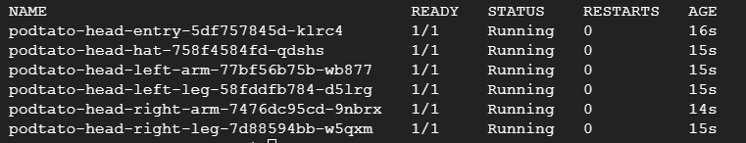
Pre-req(setup Application 1 of 2)
On the Command window, execute the below commands
kubectl apply -f https://raw.githubusercontent.com/cncf/podtato-head/main/delivery/kubectl/manifest.yaml
kubectl get pods --namespace podtato-kubectl
Verify that images were retrieved and pods started successfully
Execute the below command to expose the port outside the container
kubectl port-forward --namespace podtato-kubectl --address 127.0.0.1 svc/podtato-head-entry 9000:9000 &

Slide 4

Pre-req(setup Application 2 of 2)
Access the below link on any browser window
http://localhost:9000/
Verify that application is up and running

Slide 5
Pre-req(setup Litmus Chaos 1 of 2)
On the Cloud Shell window,open another command window execute the below commands
kubectl apply -f https://litmuschaos.github.io/litmus/3.0.0-beta7/litmus-3.0.0-beta7.yaml
kubectl get svc -n litmus
Verify that images were retrieved and pods started successfully. Note down the port Number for litmusportal-frontend-service. In this case it is 9091
Execute the below command to expose the port outside the container
kubectl port-forward --namespace litmus --address 127.0.0.1 svc/litmusportal-frontend-service 9091:9091 &

Slide 6
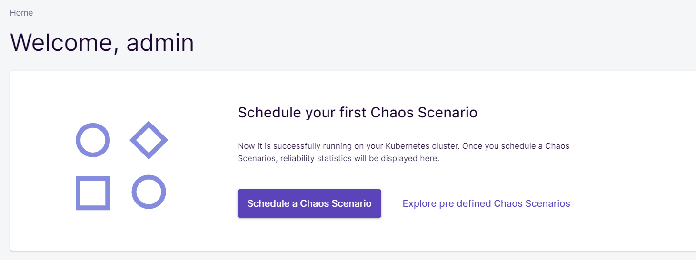
Pre-req(setup Application 2 of 2)
Access the link and enter the below credentials
http://localhost:9091/
Username : admin
password : litmus
Verify that you are able to access the application

Slide 7
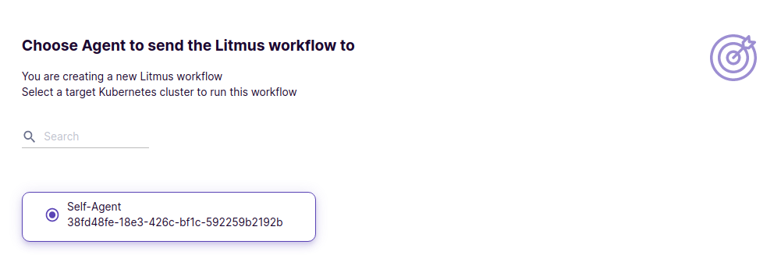
Running Chaos Experiments
Click on Schedule a Chaos Scenario from the ChaosCenter Homepage
Select Self Chaos Delegate as the target Chaos Delegate for Chaos Injection. This is where we'll select which Chaos Delegate to choose as the Chaos Delegate.
Expand the first radio button and select podtato-head from the list of Predefined Chaos Scenarios.

Slide 8
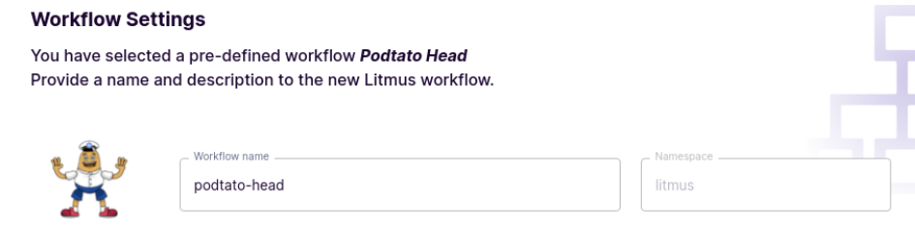
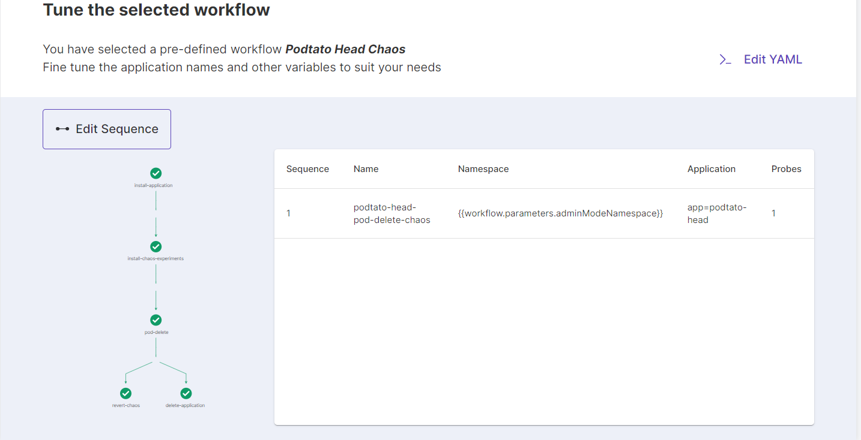
Running Chaos Experiments
View the Chaos Scenario details in the Chaos Scenario Settings, you can modify the name and description of the Chaos Scenario to suit your needs.
View the visualization of the Litmus Chaos Scenario you are about to execute. Stick to Default

Slide 9
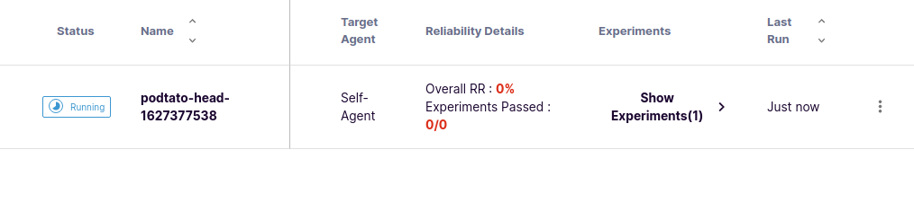
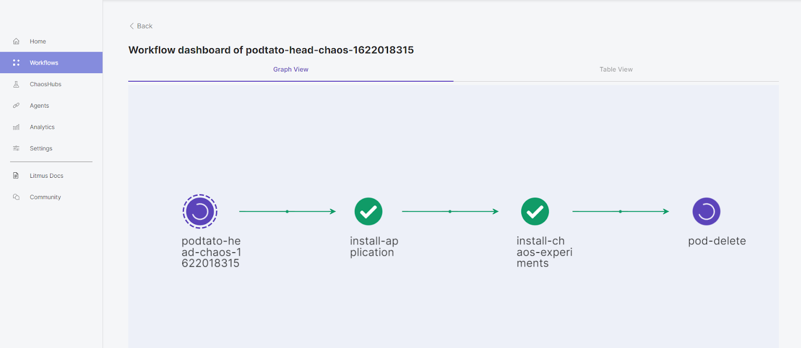
Running Chaos Experiments
To check the current progress of the Podtato-Head Chaos Scenario, view the status of the Chaos Scenario from the Litmus Chaos Scenarios Tab.
To see all these steps live in action on the chaos scenario name from the Runs Tab or select Show the Chaos Scenario from the three dot menu.

Slide 10
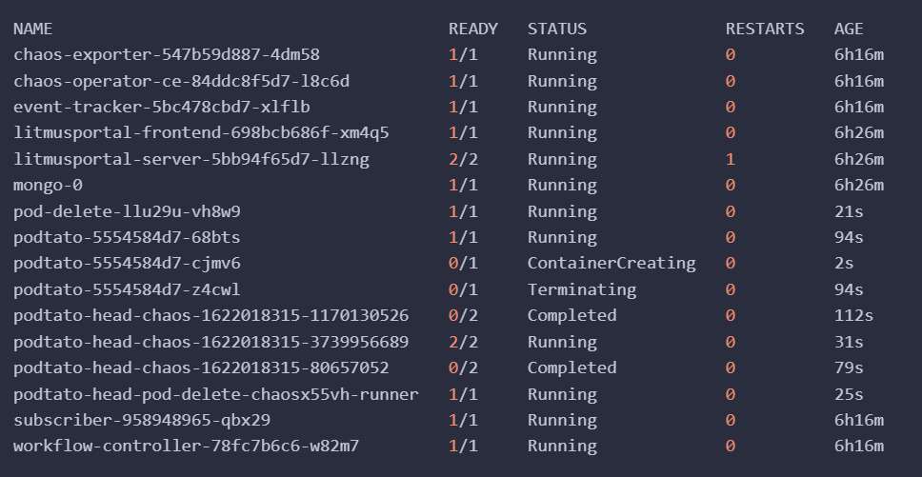
Running Chaos Experiments
To see them in action on the terminal itself watch the pods in the namespace where ChaosCenter is installed.

